Slide 1
GREENHOUSE EFFECTS
GROUP’S MEMBERS:
Noor Syazlin bt Naim
Sariah bt Mohd Salleh
Nur Aa’in Mazura bt Che Mahtar

Slide 2
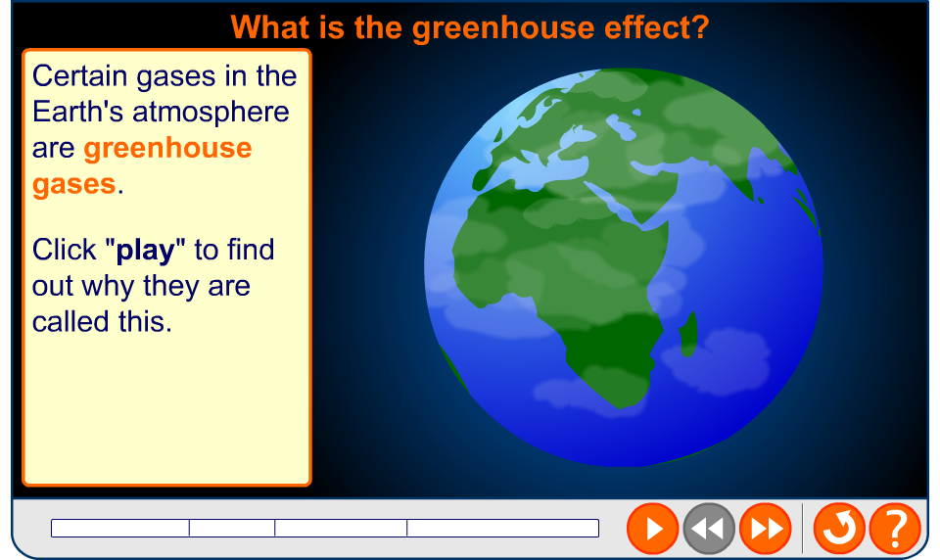
What are greenhouse gases?

Slide 3
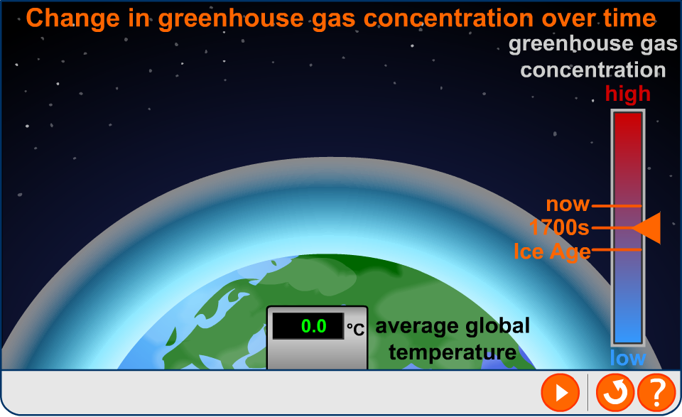
Global warming

Slide 4
Global warming potential (GWP)
is a measure of how much a given gas can contribute to global warming over a given time period.
It is measured relative to carbon dioxide

Slide 5
The GWP of a gas is calculated using the following factors:
Lifetime of the gas in the atmosphere
Ability of the gas to be absorbed infra-red radiation
molar mass of the gas

Slide 6
Greenhouse gases compared
The contribution of a greenhouse gas to global warming depends on its global warming potential (GWP) and the amount of that gas present in the atmosphere.
GWP
Greenhouse
gas
Average % of
atmosphere
After
20 years
After
100 years
water vapour
1–4
–
–
carbon dioxide
0.038
1
1
methane
0.0002
72
25
nitrogen
monoxide
0.00003
289
298
Notes:
Teacher notes
Some questions to discuss here might include:
What does this data tell you about the relative stabilities of methane and nitrogen monoxide in the atmosphere?
Why is no GWP given for water vapour?
Does this information help us decide where to focus our efforts in tackling global warming and climate change?
Full data for all greenhouse gases can be downloaded from the IPCC website, and is included in this IPCC report:
http://ipcc-wg1.ucar.edu/wg1/Report/AR4WG1_Print_Ch02.pdf [November 2008]
Water vapour is estimated to be the most powerful of these greenhouse gases. Its concentration in the atmosphere varies depending on the temperature so no GDP is calculated for it.
Other greenhouse gases include CFCs (and their replacements), sulfur hexafluoride and ozone.

Slide 7
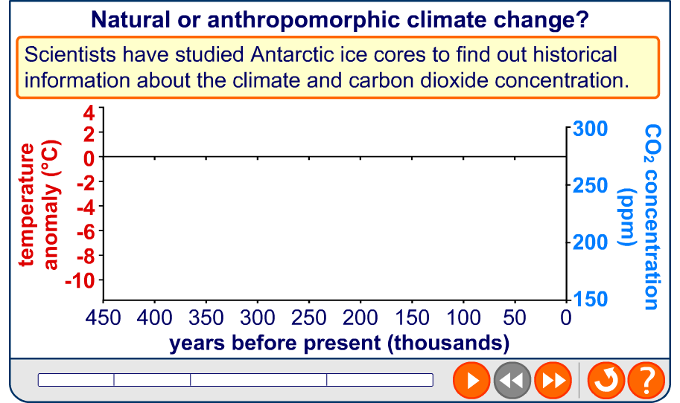
Causes of climate change
Notes:
Data: Historical CO₂ data from the Vostok ice core, courtesy of NOAA and WDC Paleo (www.ncdc.noaa.gov/paleo/icecore/antarctica/vostok/vostok_co2.html).
Petit, JR et al. 1999. Climate and atmospheric history of the past 420,000 years from the Vostok ice core, Antarctica. Nature 399: 429-436.
Historical temperature anomaly data Petit, J.R., et al., 2001, Vostok Ice Core Data for 420,000 Years, IGBP PAGES/World Data Center for Paleoclimatology Data Contribution Series #2001-076. NOAA/NGDC Paleoclimatology Program, Boulder CO, USA. (ftp://ftp.ncdc.noaa.gov/pub/data/paleo/icecore/antarctica/vostok/deutnat.txt)
Temperature anomaly is temperature difference wrt the mean recent time value.
CO₂ from 1860: 1861-1958 Etheridge, D. M. et. al., 1998, Historical CO2 record derived from a spline fit (20 year cutoff) of the Law Dome DE08 and DE08-2 ice cores, courtesy of CDIAC (http://cdiac.esd.ornl.gov/ftp/trends/co2/lawdome.smoothed.yr20)
1959-2003 from the Mauna Loa observatory, Hawaii, courtesy of NOAA. Continuous measurement of CO₂ levels began in 1958
Temperature anomaly from 1860: Data from the UK Metrological Office (www.met.gov.uk).
Temperature anomaly is the difference from the 1961-1990 average.
Teacher notes
The data suggests a strong link between carbon dioxide levels and temperature, but does not prove such a link. Many factors affect the temperature, not just levels of CO₂. Ice cores are indirect proxy records and historical temperature data is a reconstruction based on deuterium levels in the ice core.
The second set of graphs suggest and increase in CO₂ levels since the Industrial Revolution.

Slide 8

How scientists can help?
Analyses the available evidence
Investigate the viability of controversial solutions
To find out the current extent of the problem
Predicts its future extent
eg: carbon capture and storage
Notes:
Teacher notes
CCS involves the capture of CO₂ emissions and their storage in geological formations or in the oceans as mineral carbonates. The impact of this on the environment are unknown, but scientists can help to predict what may happen.

Slide 9
The role of co-operation
STERN REPORT
Stated that global warming could have a massive economic cost.
KYOTO PROTOCOL
reduce greenhouse gas emissions by a certain amount in a certain time.
Notes:
Teacher notes
The full Stern report can be downloaded here: http://www.hm-treasury.gov.uk/stern_review_final_report.htm [November 2008]
The Kyoto protocol was initially adopted for use on 11 December 1997 in Kyoto, Japan, and entered into force on 16 February 2005. Talks are currently in progress to set up a successor to the Kyoto protocol. Agreements are expected to be reached in December 2009.

Slide 10
The effects of global warming
Negative effects
Positive effects

Slide 11

POSITIVE EFFECTS
The next ice age may be prevented from occurring.
Northwest Passage through Canada's formerly-icy north opens up to sea transportation.
Less need for energy consumption to warm cold places.
Fewer deaths or injuries due to cold weather.

Slide 12
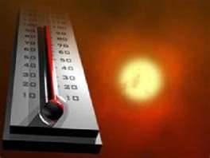
NEGATIVE EFFECTS
Increase in average global temperatures (AVT)
- The AVT has increased by 0.6◦C over 140 years.
- The climate could increase up to 6◦C in the next 150 years.

Slide 13
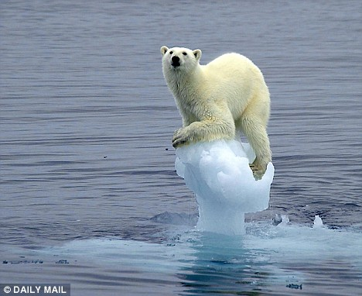

NEGATIVE EFFECTS
b) Shrinking ice caps
- The artic sea ice has decreased in area by 38% since 1979.
- This melting is caused by rising temperature.
- Leads to loss of animal habitats (eg: polar bear)

Slide 14
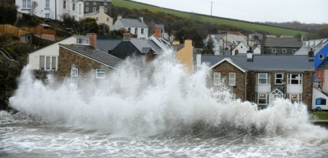
NEGATIVE EFFECTS
c) Rising sea level
Global average sea levels has risen 5cm in 1992.
This is at least partly due to melting ice caps.
It leads to an increase in flooding.

Slide 15
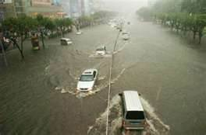
NEGATIVE EFFECTS
d) Extreme local weather conditions
Local weather patterns are changing, with increasing incidences of extreme weather
Eg: flooding , storms, droughts

Slide 16
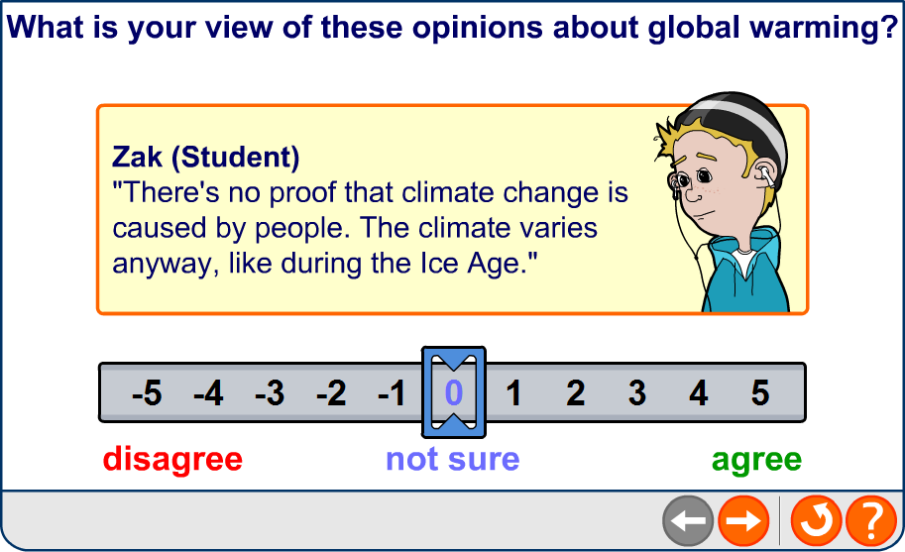
WHAT DO YOU THINK?

Slide 17
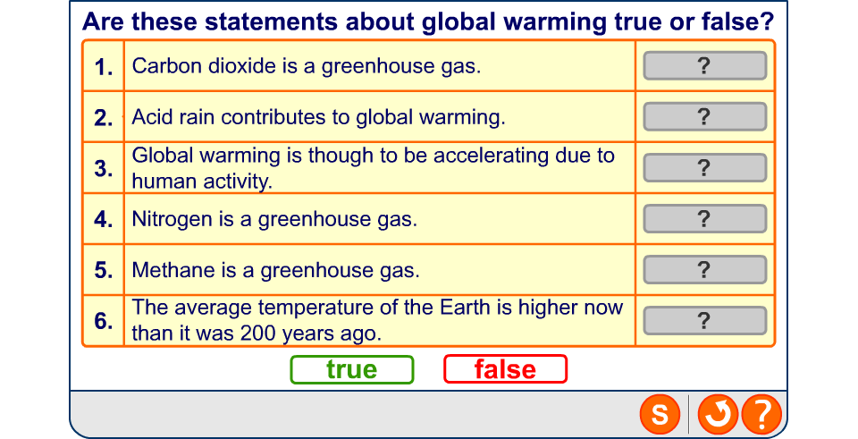
Global warming: true or false?

